Slide 1
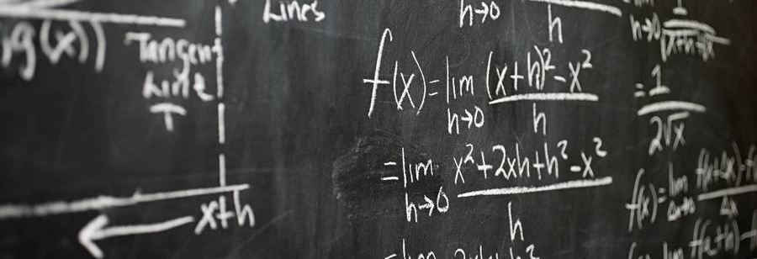
Multi-variate Linear Regression 3
Deep-Learning Seminar ch.11

Slide 2


Contents
1. for Several Samples - Theory
2. for Several Samples - Implementation

Slide 3
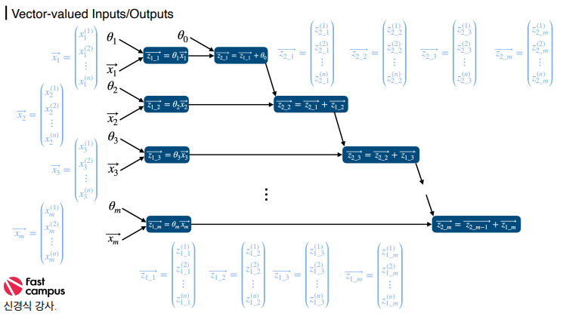
1. for Several Samples - Theory

Slide 4
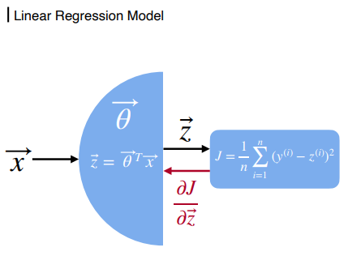
1. for Several Samples - Theory

Slide 5
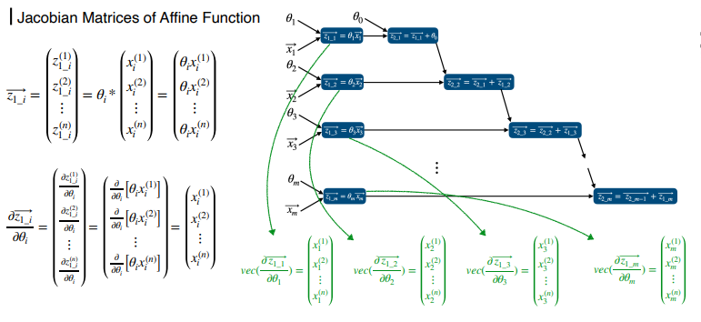
1. for Several Samples - Theory

Slide 6
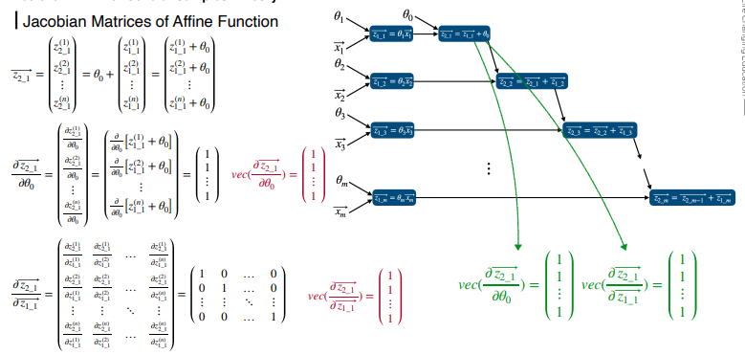
1. for Several Samples - Theory

Slide 7
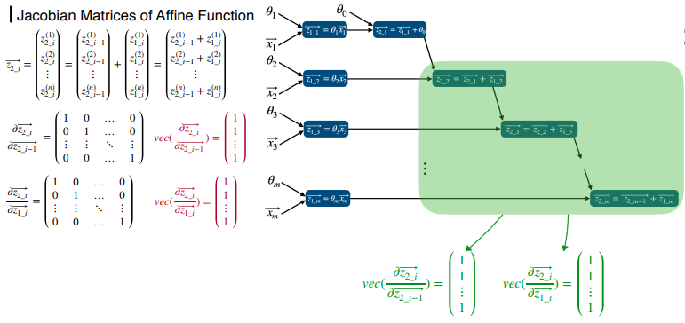
1. for Several Samples - Theory

Slide 8
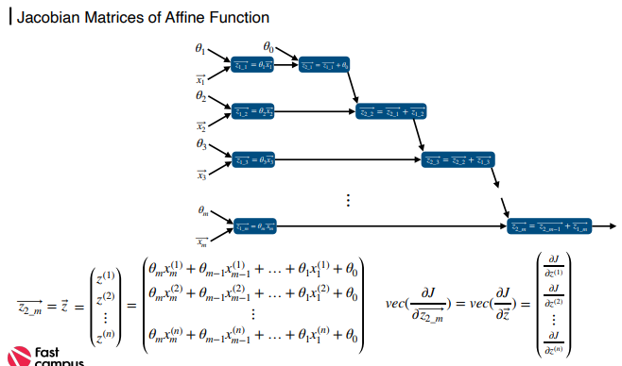
1. for Several Samples - Theory

Slide 9
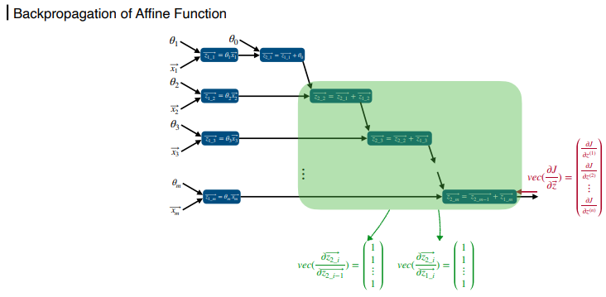
1. for Several Samples - Theory

Slide 10
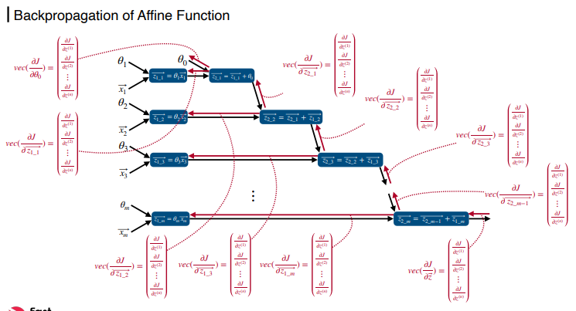
1. for Several Samples - Theory

Slide 11
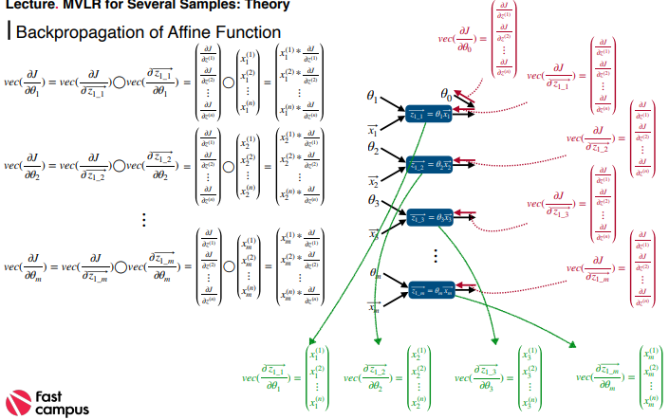
1. for Several Samples - Theory

Slide 12
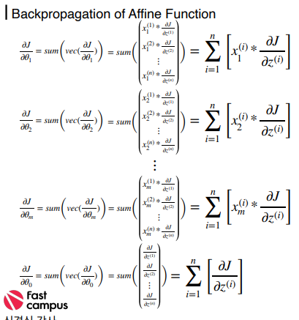

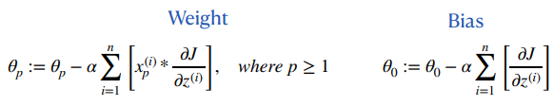
1. for Several Samples - Theory

Slide 13
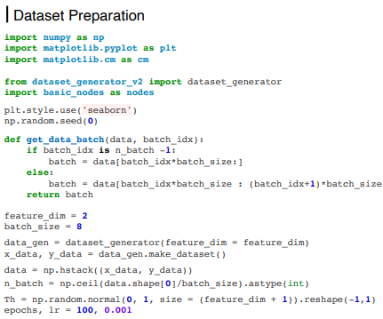
2. for Several Samples - Implementation

Slide 14
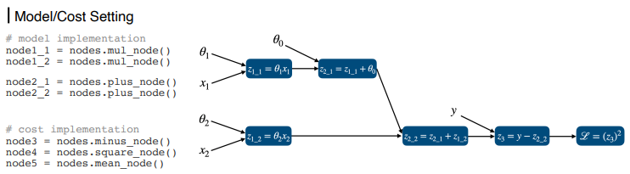
2. for Several Samples - Implementation

Slide 15
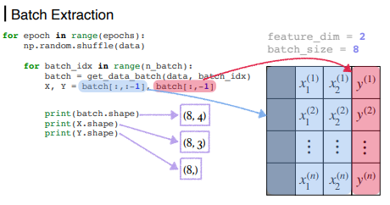
2. for Several Samples - Implementation

Slide 16
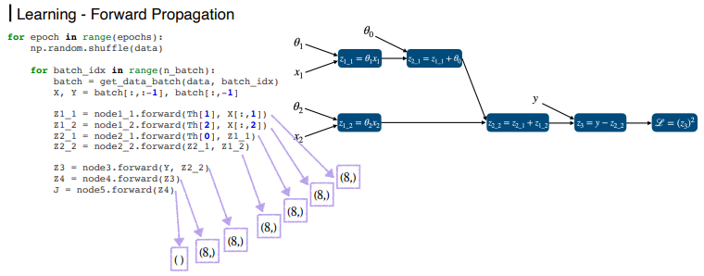
2. for Several Samples - Implementation

Slide 17
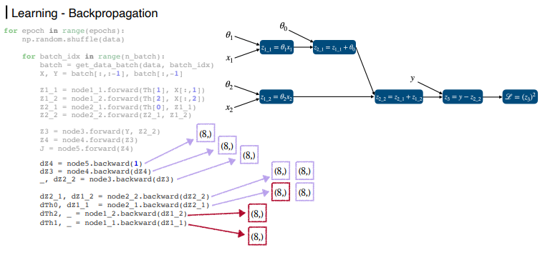
2. for Several Samples - Implementation

Slide 18
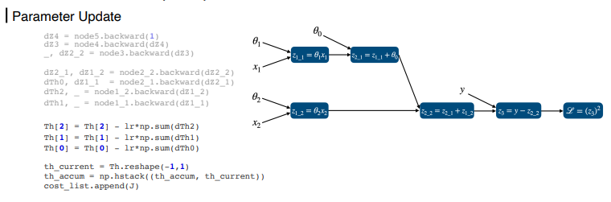
2. for Several Samples - Implementation

Slide 19
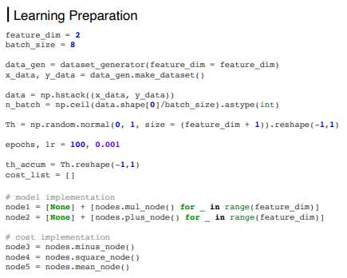
2. for Several Samples - Implementation

Slide 20
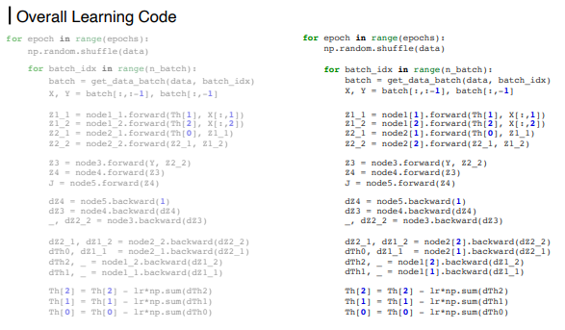
2. for Several Samples - Implementation

Slide 21
감사합니다

